Slide 2
Notes:
- Death rates: US Mortality Volumes 1930 to 1959, US Mortality Data 1960 to 2015, National Center for Health Statistics, Centers for Disease Control and Prevention.
- Cigarette consumption: 1900-1999: US Department of Agriculture. 2000-2015: Wang, TW et al. PMID: 27932780

Slide 3
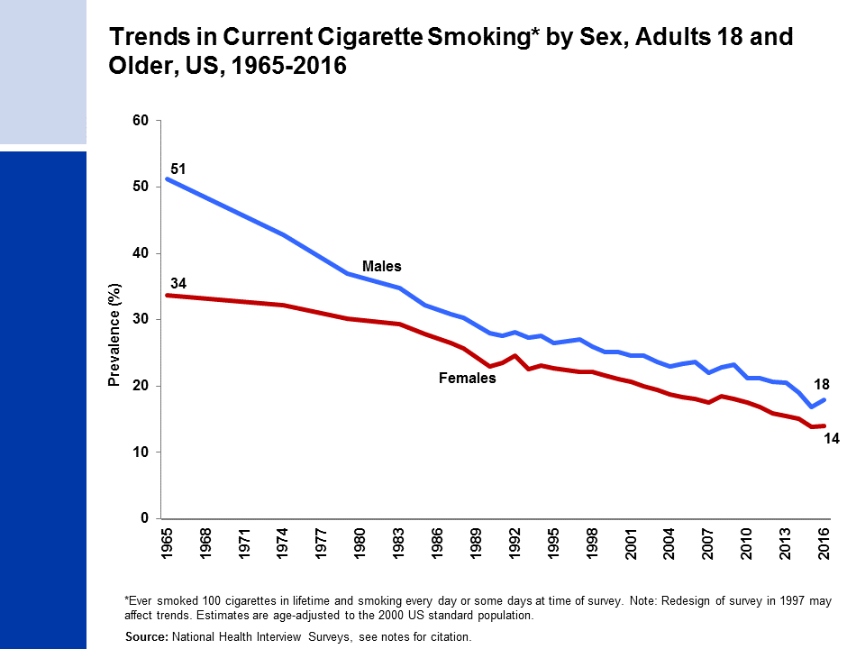
Notes:
- National Center for Health Statistics. Health, United States, 2016: With Chartbook on Long-term Trends in Health. Hyattsville, MD.
- National Health Interview Survey, National Center for Health Statistics, Centers for Disease Control and Prevention, 2016. Public-use data file and documentation. https://www.cdc.gov/nchs/nhis/index.htm

Slide 4
Notes:
- National Center for Health Statistics. Health, United States, 2015: With Special Feature on Racial and Ethnic Health Disparities. Hyattsville, MD.
- National Health Interview Survey, National Center for Health Statistics, Centers for Disease Control and Prevention, 2015 and 2016. Public-use data file and documentation. https://www.cdc.gov/nchs/nhis/index.htm

Slide 5
Notes:
- National Health Interview Survey, National Center for Health Statistics, Centers for Disease Control and Prevention, 2016. Public-use data file and documentation. https://www.cdc.gov/nchs/nhis/index.htm

Slide 6
Notes:
1999: Centers for Disease Control and Prevention. PMID: 11057729
2000: Centers for Disease Control and Prevention. PMID: 11902401
2002: Marshall L, et al. PMID: 16708059
2004: Bloch AB, et al. PMID: 15800473
2006 & 2009: Arrazola RA, et al. PMID: 20798668
2011 & 2012: Arrazola RA, et al. PMID: 24226625
2013: Arrazola RA, et al. PMID: 25393220
2014: Arrazola RA, et al. PMID: 25879896
2015: Singh T, et al. PMID: 27077789
2016: Jamal A, et al. PMID: 28617771

Slide 7
Notes:
- Monitoring the Future Study, 1976-2016, University of Michigan. Available from: http://monitoringthefuture.org/data/16data/16cigtbl7.pdf

Slide 8
Notes:
National Center for Health Statistics. Health, United States, 2013: With Special Feature on Prescription Drugs. Hyattsville, MD.
National Center for Health Statistics. National Health and Nutrition Examination Survey, 2011-2016. Public-use data files and documentation. https://wwwn.cdc.gov/nchs/nhanes/Default.aspx

Slide 9
Notes:
National Center for Health Statistics. Health, United States, 2013: With Special Feature on Prescription Drugs. Hyattsville, MD.
National Center for Health Statistics. Health, United States, 2016: With Chartbook on Long-term Trends in Health, Hyattsville, MD.
Hales CM, Carroll MD, Fryar CD, Ogden CL. Prevalence of obesity among adults and youth: United States, 2015–2016. NCHS data brief, no 288. Hyattsville, MD: National Center for Health Statistics.

Slide 10
Notes:
Hales CM, Carroll MD, Fryar CD, Ogden CL. Prevalence of Obesity Among Adults and Youth: United States, 2015-2016. NCHS Data Brief. 2017.
National Center for Health Statistics. National Health and Nutrition Examination Survey, 2015-2016. Public-use data files and documentation. https://wwwn.cdc.gov/nchs/nhanes/Default.aspx

Slide 11
Notes:
Centers for Disease Control and Prevention (CDC). Behavioral Risk Factor Surveillance System Survey Data. Atlanta, Georgia: U.S. Department of Health and Human Services, Centers for Disease Control and Prevention, 2016. https://www.cdc.gov/brfss/data_documentation/index.htm

Slide 12
Notes:
National Center for Health Statistics. Health, United States, 2016: With Chartbook on Long-term Trends in Health, Hyattsville, MD.
National Health Interview Survey, National Center for Health Statistics, Centers for Disease Control and Prevention, 2016. Public-use data file and documentation. https://www.cdc.gov/nchs/nhis/index.htm

Slide 13
Notes:
- Centers for Disease Control and Prevention. High School Youth Risk Behavior Survey Data, 2015. Available from URL: https://nccd.cdc.gov/youthonline/App/Default.aspx.

Slide 14
Notes:
- Centers for Disease Control and Prevention (CDC). Behavioral Risk Factor Surveillance System Survey Data. Atlanta, Georgia: U.S. Department of Health and Human Services, Centers for Disease Control and Prevention, 2015.

Slide 15
Notes:
- Centers for Disease Control and Prevention (CDC). Behavioral Risk Factor Surveillance System Survey Data. Atlanta, Georgia: U.S. Department of Health and Human Services, Centers for Disease Control and Prevention, 2015.

Slide 16
Notes:
- National Health Interview Survey, National Center for Health Statistics, Centers for Disease Control and Prevention, 2015. Public-use data file and documentation. https://www.cdc.gov/nchs/nhis/index.htm

Slide 18
Notes:
- National Health Interview Survey, National Center for Health Statistics, Centers for Disease Control and Prevention, 2015. Public-use data file and documentation. https://www.cdc.gov/nchs/nhis/index.htm

Slide 19
Notes:
- National Health Interview Survey, National Center for Health Statistics, Centers for Disease Control and Prevention, 2015. Public-use data file and documentation. https://www.cdc.gov/nchs/nhis/index.htm

Slide 21
Notes:
- Walker, et al. PMID: 28837546

Slide 23
Notes:
- National Health Interview Survey, National Center for Health Statistics, Centers for Disease Control and Prevention, 2015. Public-use data file and documentation. https://www.cdc.gov/nchs/nhis/index.htm

Slide 24
Notes:
- National Health Interview Survey, National Center for Health Statistics, Centers for Disease Control and Prevention, 2015. Public-use data file and documentation. https://www.cdc.gov/nchs/nhis/index.htm

Slide 26
Notes:
- National Health Interview Survey, National Center for Health Statistics, Centers for Disease Control and Prevention. Public-use data files and documentation. https://www.cdc.gov/nchs/nhis/index.htm

Slide 27
Notes:
- National Health Interview Survey, National Center for Health Statistics, Centers for Disease Control and Prevention, 2015. Public-use data file and documentation. https://www.cdc.gov/nchs/nhis/index.htm

Slide 28
Notes:
- National Health Interview Survey, National Center for Health Statistics, Centers for Disease Control and Prevention, 2015. Public-use data file and documentation. https://www.cdc.gov/nchs/nhis/index.htm

